Slide 1
Open Plan at UCSF
Change Support for Change Agents
Town Hall Meetings
February 1, 2018, HSW 303
February 6, 2018, Genentech Hall N 114

Slide 2
Agenda
Welcome: EVCP Dan Lowenstein
Overview: Open Plan Design at UCSF?
Lessons Learned
Components of Open Plan
The Change Agent Role
Resources for Change Agents
Building Updates (Clinical Sciences Building and Center for Vision Neuroscience on Block 33)
Project Timelines
Resources and Information

Slide 3
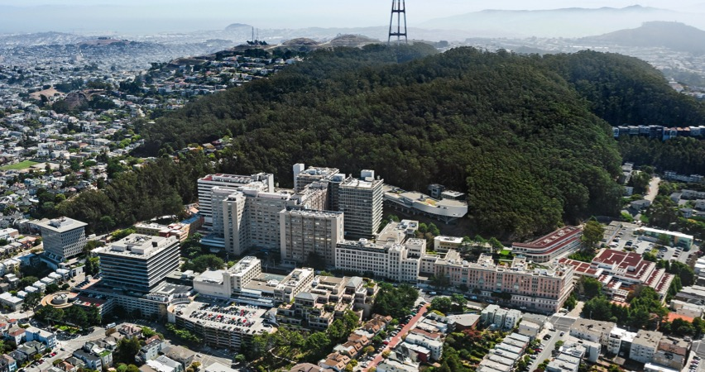
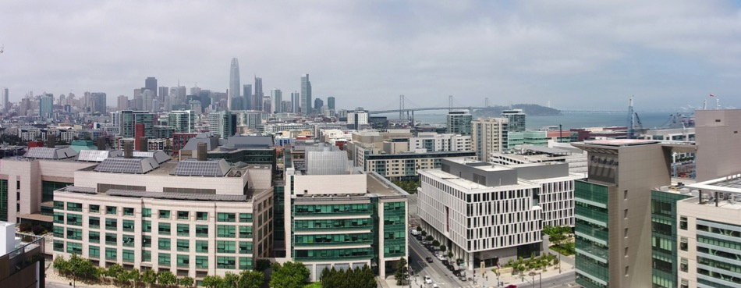
Notes:
Dan Lowenstein opening remarks

Slide 4
What is Open Plan at UCSF?
Open Plan as implemented at UCSF is a model for desktop environments that:
Provides a variety of flexible work spaces for occupants use as their activities shift during the day.
Maximizes occupant access to views and natural light as low-walled work stations are typically located near windows while enclosed offices and work rooms are located in the interior.
Allows for flexibility for growth and contraction to business needs.
Continues to evolve as UCSF’s needs change and lessons from Mission Hall are applied.
By adopting Open Plan design, UCSF is better equipped to
accommodate cost-effective growth in the long term.

Slide 5
Lessons Learned from Mission Hall
Include private offices in open plan design
Appropriate ratio of workstations and focus rooms to 11:1
Acoustically isolate common areas to reduce noise impact in work areas
Provide change management support
Include adjustable height desks for work stations and private offices
Provide appropriate custodial services for open plan buildings upon moving-in
Provide orientation to occupants on use of technology
Notes:
Both Clinical Sciences Building and the Center for Vision Neuroscience have taken into account many lessons learned from Mission Hall. These lessons learned include …….

Slide 6
Components of Open Plan at UCSF
Workstation
Private office/Focus room
This model provides a variety of work spaces for occupants to
move within their work environment as their activities shift.
Notes:
Please note the images depicted here are a sample of what a workspace may feel like, and is in no way a depiction of actual spaces in Clinical Sciences or Center for Vision Neuroscience. The Open Plan model includes,
* Assigned Workstations with partitions that provide seated visual privacy and lockable storage for personal belongings typically located near windows.
Assigned Private Offices; Unassigned and unscheduled Focus rooms for access to quiet space to do focused work and/or take private phone calls/one-one meetings for those who work at the work stations, typically located on the interior of the building;
Criteria for office assignment are being finalized and will be shared with change agents in the coming months as part of the tool-kit;
these will help managers and leadership manage space assignment within their space blocks.

Slide 7
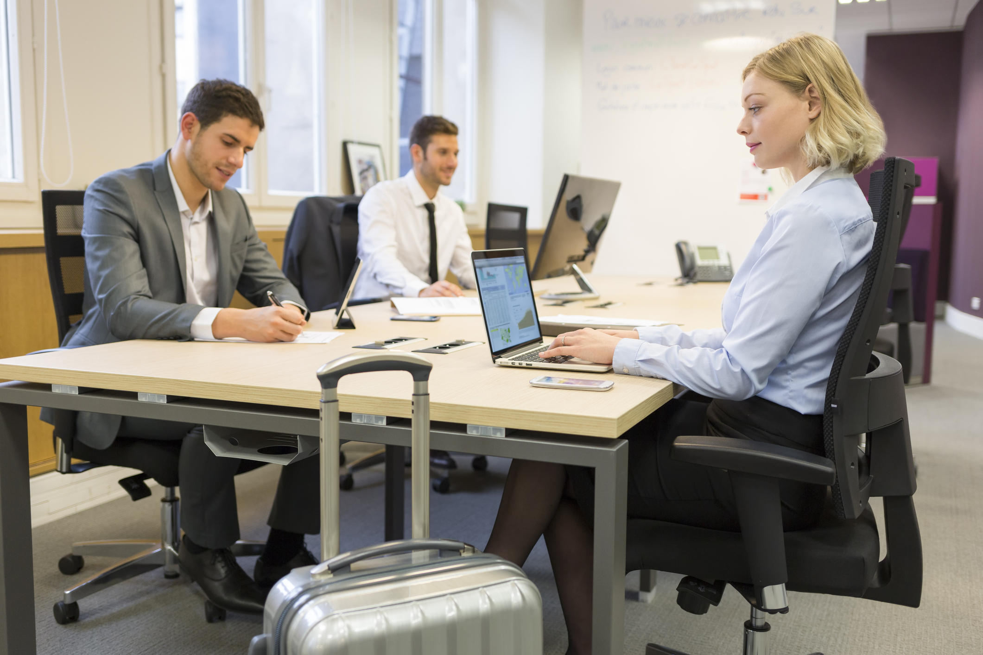
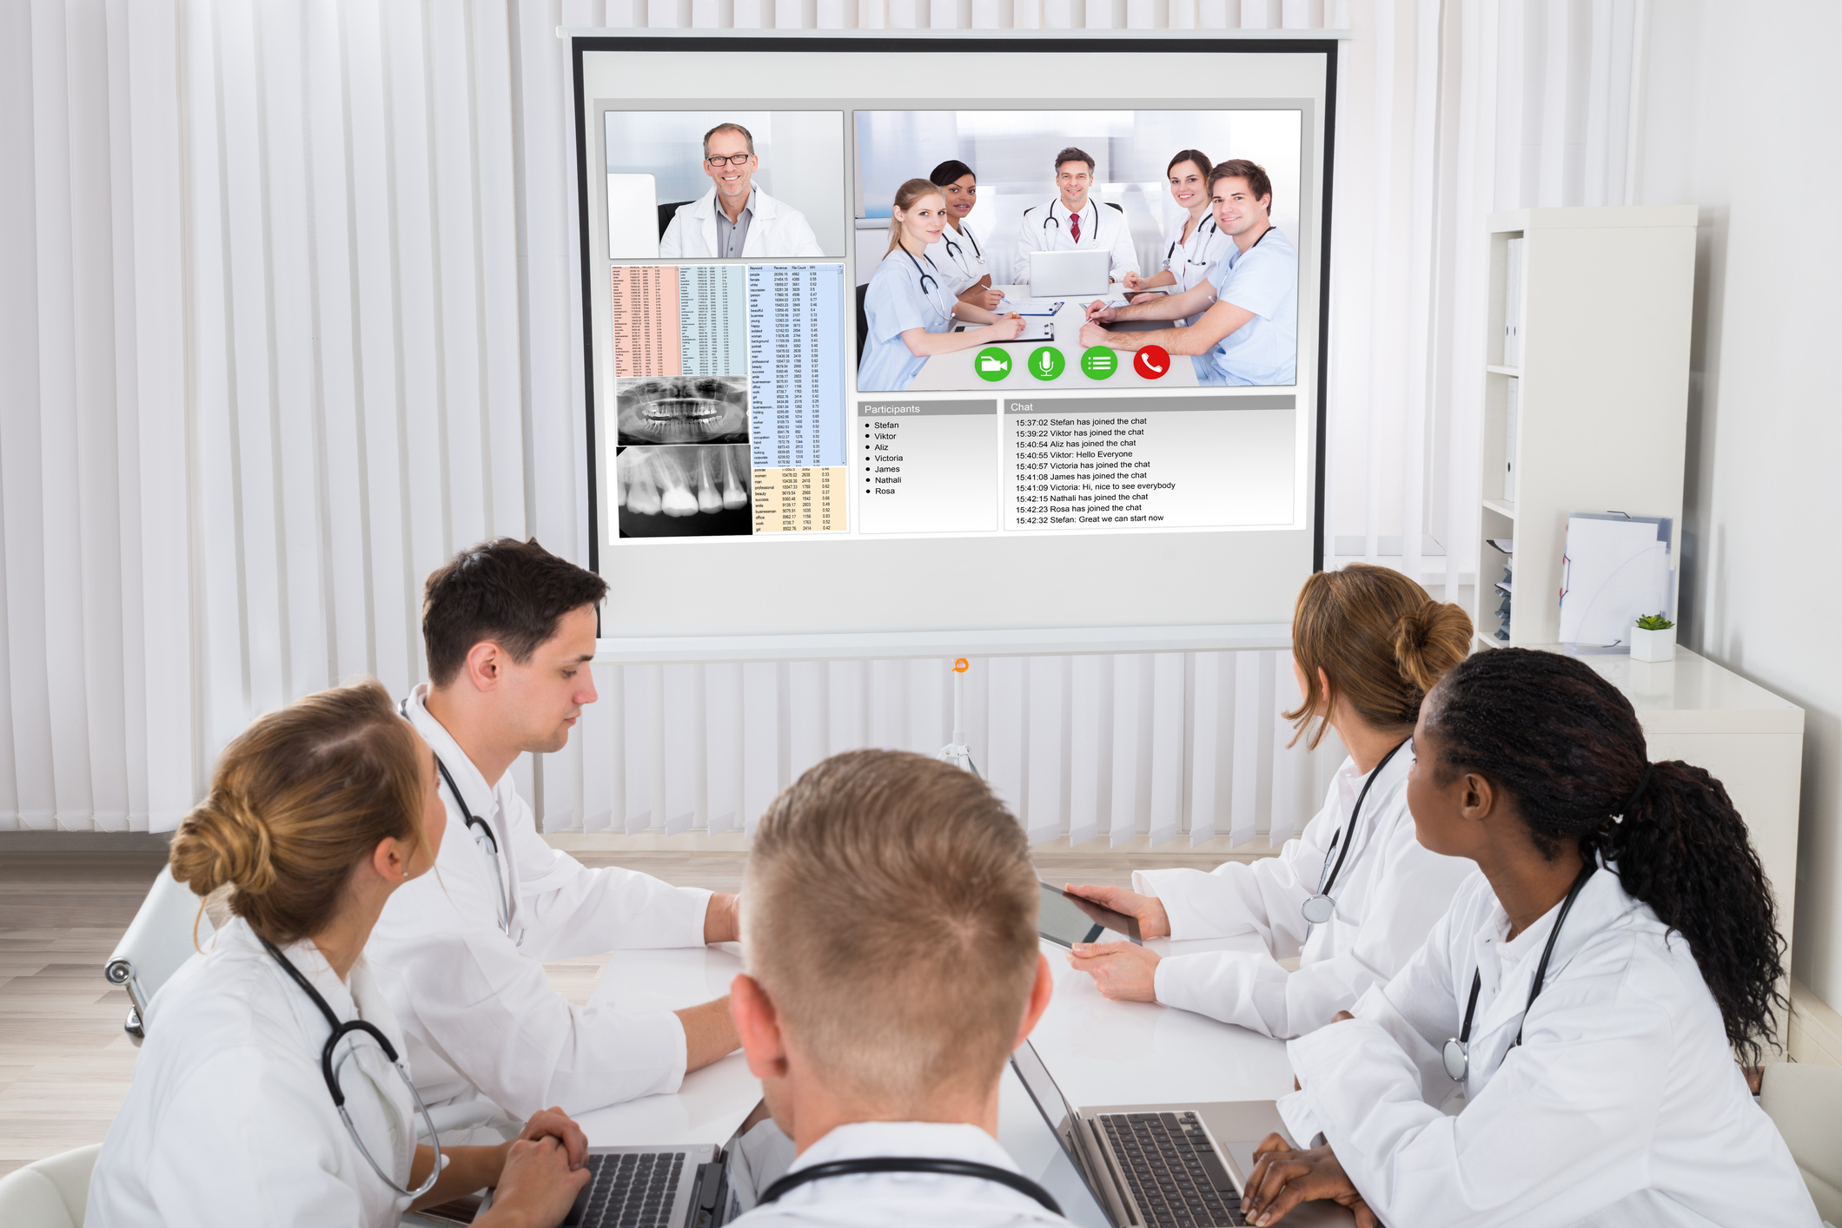
Components of Open Plan at UCSF
Hotel Workstation
Huddle room
Technology, such as laptops and wifi, supports individuals’ ability
to move seamlessly between work spaces in the building.
Notes:
Shared kitchen/break room areas – which have been isolated from the work areas to prevent so much sound transference.
Variety in sizes of shared conference rooms
Hotel stations are unassigned and available to visitors
Huddle rooms are generally unassigned and unscheduled and are intended for small group meetings;
Conference Room management recommendations have been developed for open plan and will be shared once they are confirmed.
Are there any questions??

Slide 8
The Change Agents Role
Partner with Cristina Morrison, Change Manager, to facilitate communication and dialogue with staff and faculty.
Understand how and why Open Plan is being implemented at UCSF to support staff and faculty moving into new space.
Identify types of resources needed to begin supporting staff and faculty at the right time as planning continues for moving to new space.
Serve as primary contact for staff and faculty within your group to alleviate concerns and anxiety and facilitate change.
Engage with and inform department leadership as needed.
Change Agents are UCSF’s ambassadors to inform and
engage employees about Open Plan.
Notes:
What does the change agent role mean? Change agents are ambassadors that will inform and engage employees about open plan;
I am your partner and will facilitate communication and dialogue with you, your staff and faculty and leadership;
I will support you in understanding how and why open plan is being implemented at UCSF and how it is continuously evolving.
We will work together so you may identify types of resources needed to better support your staff and faculty during this transition;
You’ll serve as the primary contact and conduit of information for your staff and faculty; by working with someone they know, this will help alleviate concern and anxiety about these changes;
You will inform department leadership as needed on progress, and I will partner with you when you’d like me to.
I am leading presentations with leadership to help them understand our work and to support each of you from the top. For example, I am presenting at the SOM Chairs and Directors meeting in Spring 2018, as well as to the UCSF Space Committee with my partner, Mara Fellouris. In addition, I provide quarterly status updates to our executive sponsors and leadership at UCSF.
Are there any questions?

Slide 9
What Can I do Now?
Attend Document Management Software Demo Day on Thursday February 15, from 1 – 5 p.m. in HSW-302.
Determine which documents need to move: review document retention recommendations
Sign-Up to attend Open Plan Document Management workshops to learn retention rules and options for digitizing documents that are moving – email 3 preferred dates to Cristina.Morrison@ucsf.edu
Work with Cristina Morrison to begin scheduling meetings with staff and faculty to present high level overview of Open Plan and Change Support Project
Share Communication resources (space.ucsf.edu, Chatter) and participate in dialogue on Chatter.
Notes:
You’ll see on the sign-in sheets there is a list of dates/times/locations for the 8 document management workshops that will be led by Carolyn Tuft, our project manager for records and information management in the Real Estate, Planning and Capital Programs department (REPCAPS)
When you sign-in, if you haven’t already done so, review the dates and send me an email with your 3 preferred options. I will also post on Chatter and send an email on February 7 with these next steps and reminders.
I encourage each of you to serve as a conduit of information to ensure communication is driven as a dialogue with staff and faculty.
I encourage each of you to get to know one another, to build a network of support and an opportunity to share best practices as we all continue to adapt to open plan at UCSF.
Share information on Chatter, share best practices
Questions?

Slide 10
Where can I find information?
https://space.ucsf.edu/open-plan-change-support-project
Change Agents Group on Chatter
Email updates will be sent after the town halls
What is the timeline between now – Summer 2018?
February 2018: Town Halls with Change Agents.
February – March: Open Plan Document Management Workshops with Carolyn Tuft.
Spring 2018 – Summer 2018: develop presentations, schedule meetings with departments/units, provide ongoing building project updates, ongoing partnering with partners in REPCAPS (Real Estate, Planning & Capital Programs).

Slide 11
What’s Next?
Leadership presentations
By late summer, finalize tools and equipment
Present conference room management recommendations to leadership
Develop budgets for shared services funding model
Notes:
The Tools and Equipment component of the plan includes recommendations on what type of equipment to provide for staff and faculty, such as budgeting for laptops by the time the moves happen. In some cases headsets will be recommended, and/or cell phones. These recommendations will evolve as we move forward.
We are here in the process and are working with an advisory group of 8 people providing support.
We have faculty partners who provide input and are a resource to understand faculty needs, and a relationship with the Academic Senate.
As the project continues, guidelines will be developed with partners in REPCAPS for etiquette in an open plan environment, governance and space management information and policies,
I will now hand off Debra/Patti and Don Rudy to provide updates on the Clinical Sciences Building and the Center for Vision Neuroscience.

Slide 12
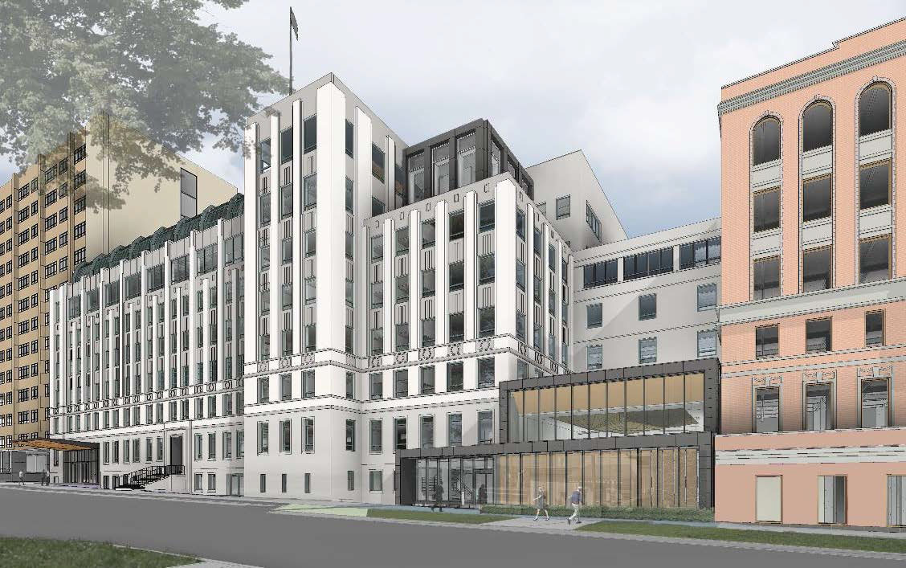
Clinical Sciences Building Project Update
​
Notes:
Debra present project overview
Construction: the team has been focused on preparing for construction and other behind the scenes work. Construction activity is scheduled to begin in mid-February. The most recent changes near CSB are along the Saunders Court area where more permanent fencing and lighting was installed to improve safety and security in the area.
What is happening in Saunders Court? The area is being used for staging throughout the project.
The CSB Project is expected to be complete in December 2019. We will continue to provide updates.
CSB FAQ are available on the space.ucsf.edu website
A CSB Town Hall is being scheduled for Spring 2018 and will be open to the whole Parnassus campus community.

Slide 13
CSB Project Update Amenities
​
New pass-through will connect Parnassus Ave. to Saunders Court.
Lower level and first floor will feature multi-purpose spaces with cutting edge technology managed by Educational Technology Services.
Floor plans are consistent with open plan objectives whereby workstations are along the windows and other rooms are on the interior.
Shared conference rooms will be available throughout the building.
Lactation room for nursing mothers.
Access to food, gymnasium and other amenities at the Parnassus campus.
Mount Sutro hiking trails and local neighborhood shops and restaurants.
Project Email: CSB_Seismic@ucsf.edu
Notes:
Debra to present

Slide 14
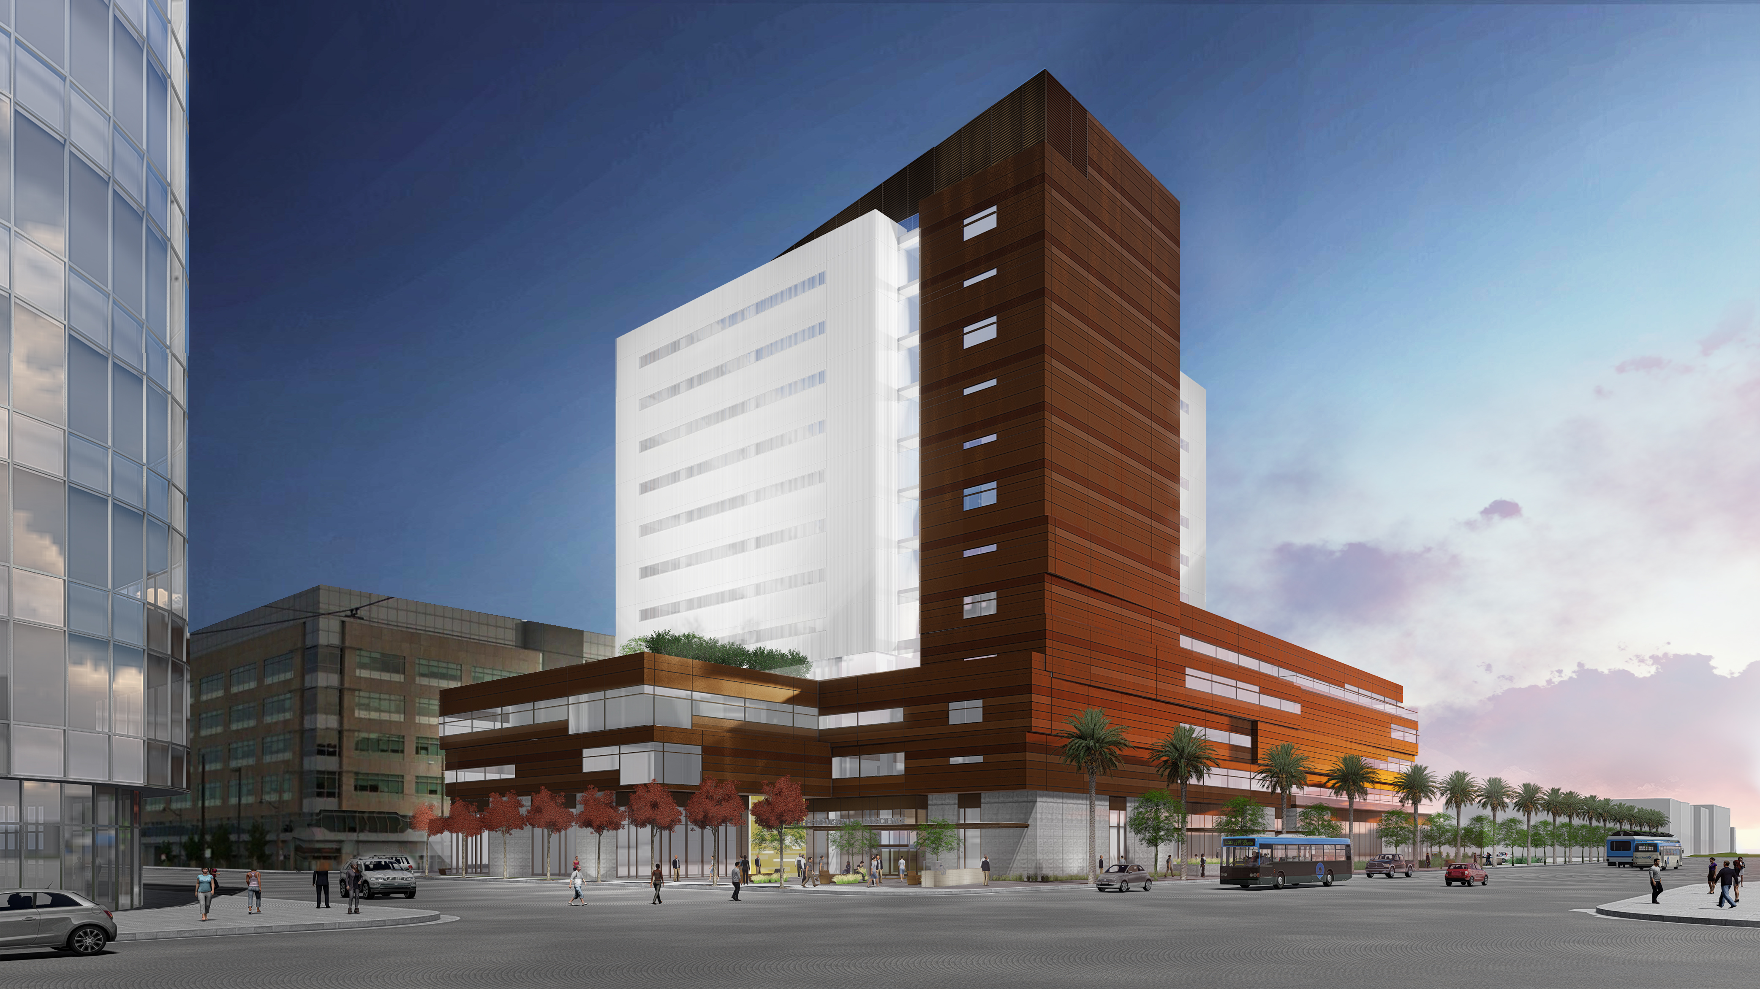
Center for Vision Neuroscience Update (on Block 33)
​
Notes:
Don Rudy present: The newly named UCSF Center for Vision Neuroscience on Block 33 is expected to be complete in late 2019. We will continue to provide updates and adjustments to the timeline. A story is being developed by our partners in the Development Office and University Relations which will explain the naming of the building.
Block 33 FAQ are available on the space.ucsf.edu website
Building Programming Committee will continue meeting. PM Patrick McGee and Architect/Contractor team will continue working with committee members.
A robust communications plan will support communication from the committee to change agents, which will then be supported by the Open Plan Change Support Project. Cristina Morrison is available to present information with you (change agent) at faculty and staff meetings

Slide 15
UCSF Vision Neuroscience Center Project Update Amenities
​
Project Email: block33@ucsf.edu
Shared multi-purpose rooms on first and second floor.
Hotel Hub on third floor.
Lactation rooms for nursing mothers.
Indoor bike storage and showers.
Café.
Access to Mission Bay retail, gymnasium.
Local neighborhood shops and restaurants.
Notes:
Don Rudy present

Slide 16
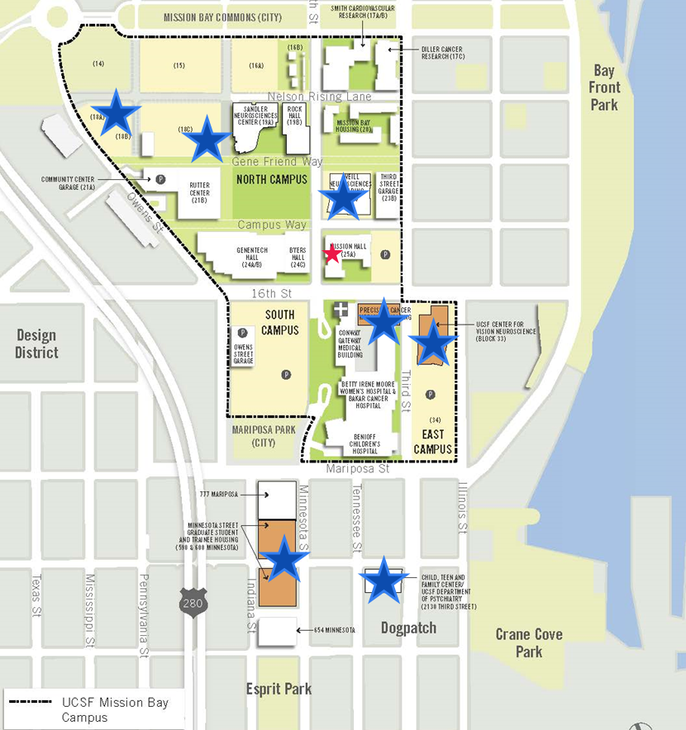
UCSF Mission Bay Construction
Notes:
Don Rudy overview all building projects at MB and Vision Neuroscience building location on the corner of 16th Street and 3rd Street.

Slide 17
Major Building Estimated Project Schedules
Timelines shown are for construction. All dates are subject to change.
2016 | 2017 | 2018 | 2019 | 2020
Vacate Laurel Heights
CSB Retrofit and Renovation
945 days
5/20/2015 - 1/1/2019
480 days
Planning/Design
Block 33: Center for Vision Neuroscience
11/17/2016 - 9/19/2018
541 days
3/20/2017 - 4/15/2019
Planning/Design
540 days
Precision Cancer Medicine Bldg.
6/6/2017 - 7/1/2019
370 days
3/13/2017 - 8/10/2018
UC Hall Decant
914 days
7/2/2017 - 12/31/2020
564 days
2/1/2017 - 4/1/2019
UCSF Research & Academic Bldg at ZSFG
Planning/Design
2015
2020
Planning/Design
Today
Child, Teen and Family Center & Dept. Psychiatry
Planning/Design
Joan and Sanford I. Weill Neurosciences Building
Planning/Design
MN Street Graduate & Student Trainee Housing
Planning
HDFCC Mount Zion to Mission Hall
Notes:
This slide includes all of the projects UCSF is currently working on through 2020 and beyond.
The light orange indicate Open Plan buildings, the dark orange are research, patient care or housing buildings, the blue indicates buildings that will be vacated/decanted.
Over 20% of UCSF staff and faculty will be in open plan buildings by 2020; open plan includes Minnesota Street, the SOM folks in U-80, Mission Hall, and the future buildings.

Slide 18
Resources and Information
Resources
http://space.ucsf.edu
Dedicated email space@ucsf.edu
Open Plan: https://space.ucsf.edu/open-plan-change-support-project
Paper lite office: https://space.ucsf.edu/records-information-management
UCSF Transportation website & my commute
UCSF Construction Impacts
Campus Life Services, Facilities Services Guide September 2017
*See high occupancy buildings on page 23
Warriors Chase Center website
Stay Connected: MyAccess: Change Agents Group
Notes:
This presentation will be posted on the Change Agent chatter group as well as the space website. It can serve as a template for your staff and faculty and I’m happy to work with each of you to modify it for your groups.
Note that the Mission Bay campus is impacted by non-UCSF projects including the Chase Center, Uber, and the city’s work on Muni, which will all be very visible and impactful.

