Slide 1
Open Plan Workspace Change Management
Town Hall with Change Agents
January, 2017

Slide 2
Topics
Building Timelines and Update
What is Open Plan
Project Goals and Structure
Change Management Components
What You Can Do Now
Next Steps

Slide 3
Update on CSB
Abatement and soft demolition have been completed
Bidding renovation work shortly
Anticipate renovation construction start in early spring
Anticipated completion late 2018/early 2019
Building Info:
110,000 GSF
63 to 86 assigned seats per floor (23 to 30 PO/40-56 WS per floor)
10 to 13 un assigned hotel stations per floor
7 to 11 Focus rooms per floor
4 to 5 Huddle Rooms per floor

Slide 4
Update on Block 33
Design Build Contract awarded to Webcor Builders/Smith Group Architects
Currently in the Design Phase
Breaking ground in June 2017
Construction complete Summer 2019
Building Info:
342,000 GSF
Academic Tower is 12 Floors
Typical Academic Tower Floor Plan is 20,000 GSF
135~ seats on a typical floor (6-12); 35~ offices/100~ workstations

Slide 5
What is Open Plan?

Slide 6
Traditional Office Environment
Each suite is a ‘world unto itself’
Operational costs are managed at the suite occupant level
A large hallway allows occupants and visitors to circulate in and out without impact to neighboring suites.
The high cost of construction limits the institution’s ability to ‘right-size’ space assignments and to continuously adjust these assignments to meet each unit’s changing space needs.

Slide 7
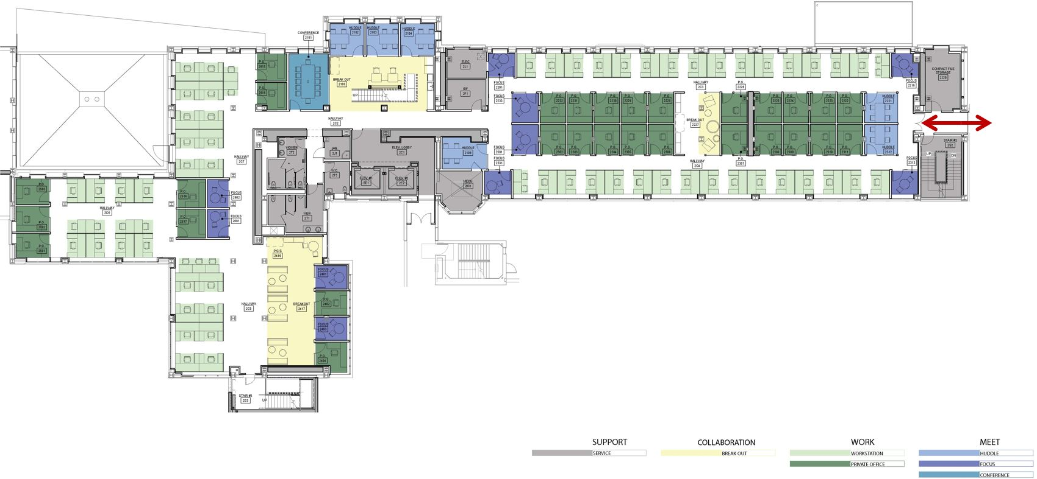
Open Plan Workspace
Public hallway has been eliminated; building floor becomes one large shared suite with an array of seating types and amenities.
Operational costs are typically shared amongst occupant groups. Successful cross-unit cohabitation necessitates more coordination.
‘Right-sizing’ and adjustment of space assignment is enabled by fluid layout.
Notes:
Add animation to bullets

Slide 8
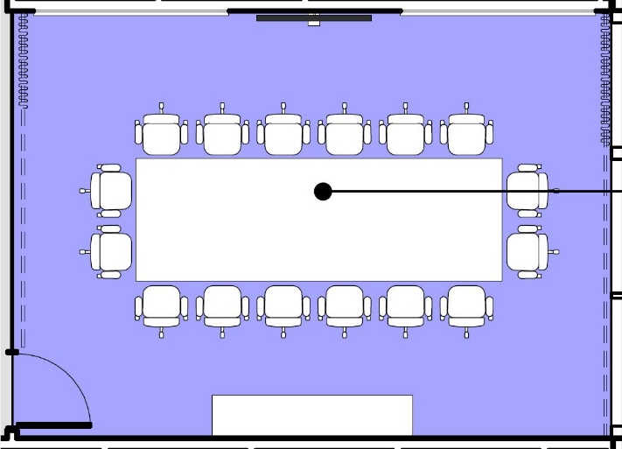
Components of Open Plan Workspace
HOTEL
WORKSTATION
FOCUS ROOM /
PRIVATE OFFICE
HUDDLE ROOM
CONFERENCE ROOM

Slide 9
Lessons Learned So Far
Need to engage early with building occupants
Acknowledge the changes that come with open plan workspace and develop a plan to ensure a smooth transition
New Open Plan Workspaces will include the following changes:
Small private offices
Enclosed kitchen and copier areas

Slide 10
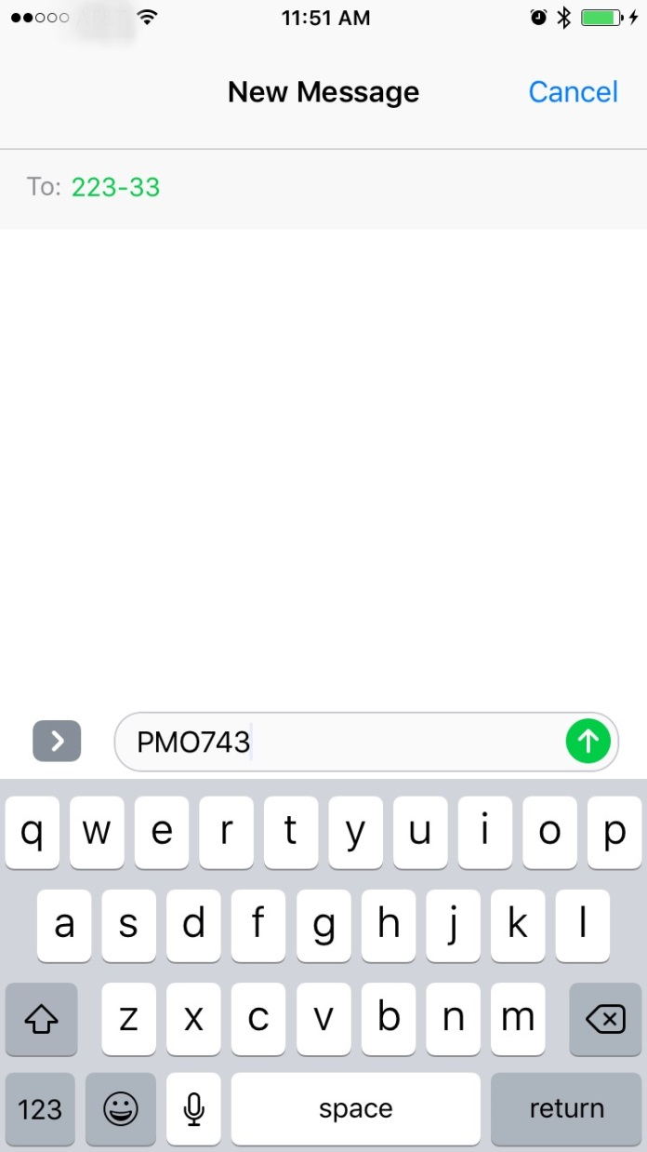
Polling Instructions
Setting up your mobile phone
or laptop
Mobile Phone:
Text to: 22333
Enter: PMO743 (not case sensitive)
into the text body
Send
Laptop:
Go to PollEv.com/pmo743

Slide 11
Notes:
Poll Title: Test: Did you have a nice weekend? https://www.polleverywhere.com/multiple_choice_polls/kcMhPI3gFRHqQRq

Slide 12
Notes:
Poll Title: What are you most excited about? https://www.polleverywhere.com/multiple_choice_polls/HJkdJYvNqDSTuO7

Slide 13
Notes:
Poll Title: What are you most concerned about? https://www.polleverywhere.com/multiple_choice_polls/54azgAekl30FCQw

Slide 14
Project Goals
Develop a change management plan for Open Plan Workspaces that will enable a smooth transition into new Open Plan Workspace buildings, CSB and Block 33
Engage with building occupants early
Plan will include these components:
Building Governance and Management
Space Assignment Strategies
Equipment and Tools
Behaviors and Norms
Department Identity
Community Building
Develop an implementation plan
Notes:
Learned many lessons at Mission Hall and want to engage with building occupants early

Slide 15
Project Structure
Executive Sponsors
Dan Lowenstein, Paul Jenny
Wear a “campus hat” to develop strategies and recommendations to facilitate the occupant and department transition to flexible open plan environments.
Design Team
Change Agents
You!
Obtain Feedback
Provide Feedback
Serve as Champions of Change for Department
Guide the execution of the work
Coordinate efforts and ensure quality deliverables.
Project Management Team
Cristina Morrison, Cara Fladd, Karin Wong, Jill Goldsmith and Mara Fellouris

Slide 16
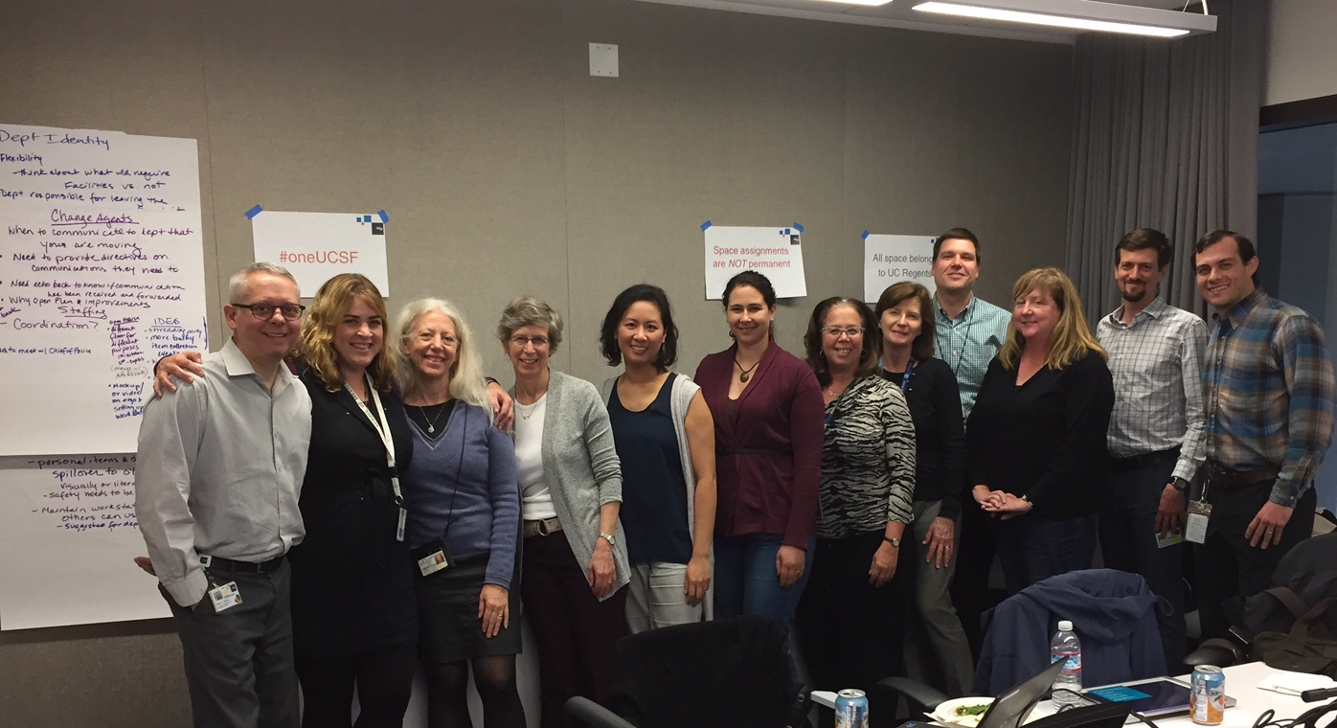
The Design Team
From Left to Right: Georgina Lopez, Kevin Souza, Cristina Morrison, Christine Razler, Jill Goldsmith, Karin Wong, Angela Rizk-Jackson, Mara Fellouris, Suzanne Murphy, Jon Rueter, Cara Fladd, Mike Billings, Adam Schnirel. Missing from photo: Patrick McGee and Sharat Israni
Notes:
Design Team included current occupants of MH and U-80, future occupants of CSB or Block 33, as well as SOM Deans office staff and central service providers, such as Facilities and Campus Planning
Met with Design Team for 4 full day sessions to develop change management plan

Slide 17
What is Change Management
Change Management is the process, tools and techniques to manage the people side of change to achieve a required outcome.

Slide 18
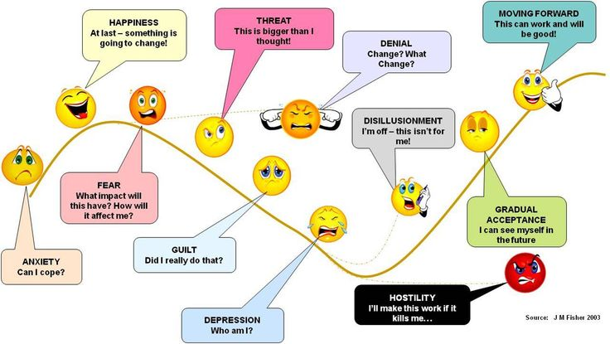
How Individuals React to Change
Notes:
Our goal is to minimize the fear, depression, hostility and threats

Slide 19
Customer Values
Notes:
Just a customer slide with wordle
Won’t discuss behaviors and norms now – too early

Slide 20
Customer Values Shared by All Groups
Functional | Emotional | Financial
Privacy Clean Child Care close by Easy access to people I work with Predictable resource availability Latest technology that works Working printers in a designated print/copy space Conference rooms on demand Training on how to use the space Strong cell reception and wifi Cafes etc nearby Space for a small library Breakspace Whiteboards Video Conferencing Ergonomic furniture | Security Quiet/sound modulation Ownership, belonging and IDENTITY Sense of community Assigned space Peaceful cohabitation Neighborliness Hierarchy of workspace Information on the new commute and impact on my life Efficient communications on key building stuff | Service level agreements with providers to meet demand Transparency
Importance of values varies by group

Slide 21
Customer Values Specific to a Group
Who are our customers? | What do they value about their workspace?
 | Functional Values | Emotional Values | Financial Values
Faculty | Privacy for PHI and FERPA Space for Research materials/Books Efficient | Natural light Sense of ownership Feeling respected | Understanding of budget Efficient funds flow Cost neutral
Staff | Privacy for PHI Storage for clinical kits (Research staff) Easy access to supplies and equipment storage for back ups (admin) Interactions | Accountability | Understanding of budget Efficient funds flow Cost neutral
Students and Applicants | Wayfinding Locating mentors Finding Deans and Support Staff Waiting areas and break rooms | Identity with a unit Student lounge Space as evaluation of our reputation Physical home | Value for tuition dollars
Service Providers | Access for deliveries/mail and services |  | Efficient funds flow
Visitors | Wayfinding Storage for luggage etc Waiting areas | Perceived reputation of university
Notes:
Is Cost neutral and Efficient Funds Flow important for Service Providers?
Do staff value efficient funds flow and cost neutral?

Slide 22
Change Management Plan Components
Governance structure and roles
New Services, Shared Costs and Funding Model
Equipment and Tools for Occupants
Transition Tools
Notes:
Also discussed Behaviors and Norms, but won’t discuss those today.

Slide 23
Governance
Open plan necessitates occupant driven governance of the space
Design Team recommends two levels of governance:
Building Wide
Development of general principles
Common use of building
Single point of contact for service provider SLAs
Block (1-x floors)
Adaptation of principles
A vehicle for decision making across multiple groups
Block leaders need to be engaged and empowered
Department Mgmt still manages the department
Notes:
From Mission Hall, we learned that Open Plan requires occupant driven governance. We have the opportunity to set this up on the front end, instead of being reactive.

Slide 24
Recommended new roles
Space and Operations Coordinator
Works with building occupants on how to work within an open plan workspace environment
Assists in verifying and documenting space assignments and analyzing space utilization
Liaison to governance committees
Floor warden or point person
Design Team recommends One Point Person/Dept. for move in and following three months
For Large Departments, may be more than one person

Slide 25
Notes:
Poll Title: Do you agree with the recommendation to have one-point person/department for move in and the following three months? https://www.polleverywhere.com/multiple_choice_polls/o086CpVJnBhPFui

Slide 26
New Shared Services
Print/Fax Management
Engage with Documents, Media and Mail to provide multi function devices
Multi Function Devices have secure printing features
Conference room management
Have either ETS or ITS manage the technology in the huddle rooms and conference rooms
Shared kitchen on each floor
Facilities maintenance and cleaning
Have Facilities take on additional maintenance and cleaning such as carpet cleaning 2x/year, maintenance of refrigerators, microwaves and water purifiers.
Notes:
Shared kitchen – with microwave, toaster oven, coffee pot, filtered water and fridge
Not your own suite, more sharing and more wear and tear, so proposing that Facilities take on additional maintenance and cleaning of these shared items.

Slide 27
Notes:
Poll Title: Does your department provide coffee and tea free of charge to staff and faculty? https://www.polleverywhere.com/multiple_choice_polls/c20gwyyzicWIyoh

Slide 28
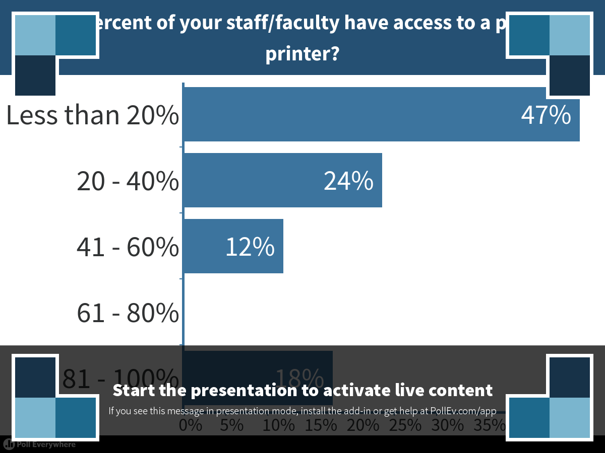
Notes:
Poll Title: What percent of your staff/faculty have access to a personal printer? https://www.polleverywhere.com/multiple_choice_polls/r4vEO7A5V1mv3qf

Slide 29
Guiding Principles on Shared Costs
Supports Great People-Great Place initiative
Efficient funds flow
Cost neutral for majority of departments in Open Plan
Equitable cost sharing pro rata – makes sense given item/service being shared

Slide 30
Shared Costs
Option A: The Campus should fund all shared costs in Open Plan buildings
Pros:
Minimize the movement of funds from department to department, which costs money to administer. By having the campus fund these shared costs, design team believes it will save money in the long run.
Everyone on campus participates equally in funding these services, since generally departments do not choose whether to be in open plan workspace or not
Funding Source options: Chancellor’s budget or take a share of the indirect costs to fund these costs
Option B: Shared costs are split between campus funded and departments sharing the costs, involves recharges between departments
Pros:
Provides incentive for departments to effectively utilize their space as departments pay for all spaces assigned to them
Participants using the services pay for a portion of them.
Notes:
20% of the population will be moving

Slide 31
Notes:
Poll Title: Which Shared Costs model do you prefer? https://www.polleverywhere.com/multiple_choice_polls/VYJ89g4xHJjU3vl

Slide 32
Supporting the new occupants in Open Plan
To Be Provided
UCSF Phone number and phone
Sit/Stand desk with privacy screen
Ergonomic chair
Secure/lockable personal storage
Built-in sturdy coat rack and name plate
Department Provides
Docking Station and monitor(s)
Laptop (or opt out to desktop only if work requires the computing power of a desktop)
Items to Help You
Tools to indicate busy or free
Tips & Training on:
Personal safety
Personal Comfort
Behaviors and Norms
Notes:
Busy/Free Tools: Standardize for the floor, some suggestions include using signage, headsets or funny hats

Slide 33
Notes:
Poll Title: What tools/events would be most helpful to you during the transition? https://www.polleverywhere.com/multiple_choice_polls/PTR07T6LrIYUneB

Slide 34
Transition Ideas
Welcome packets
On line user guides
Meet and Greet events prior to move in
Shredding Parties

Slide 35
What can you start doing now?

Slide 36
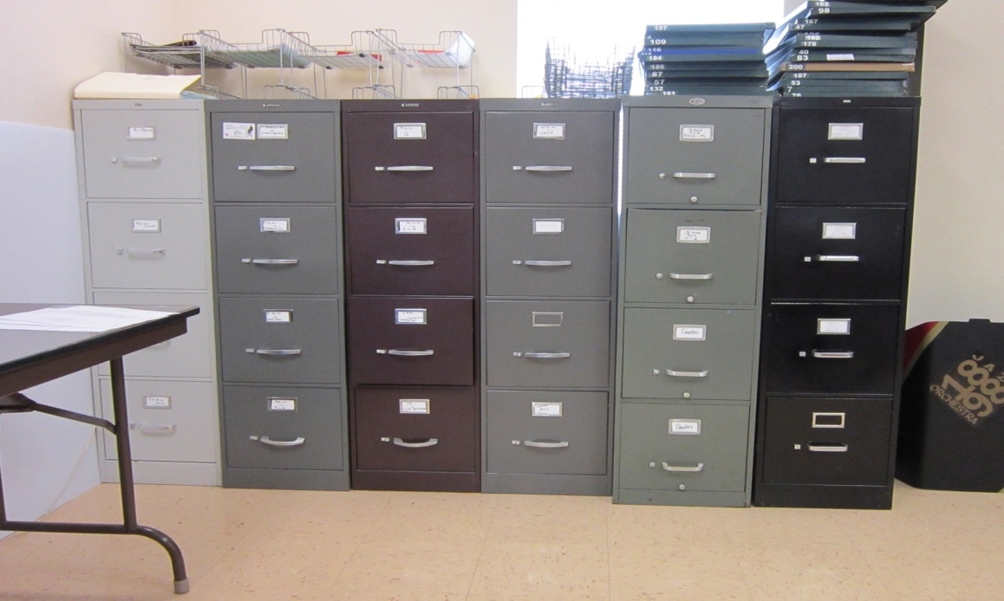
Have lots of these?

Slide 37
Start reducing paper files now

Slide 38
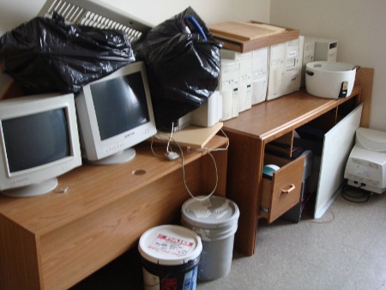
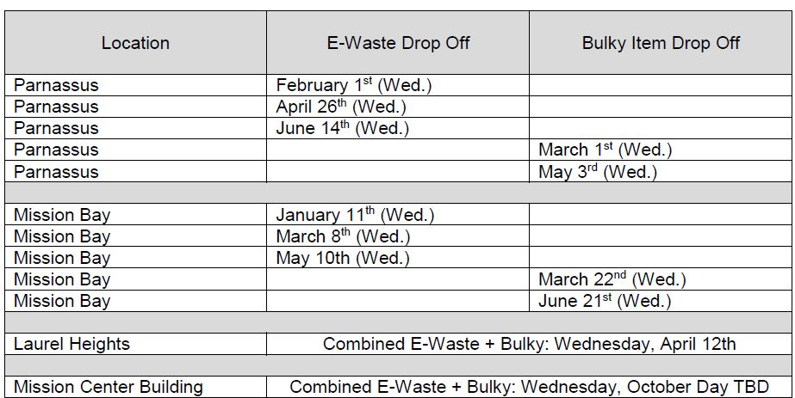
Dispose of old furniture and equipment
FREE bulky item and e-waste collection days!
http://campuslifeservices.ucsf.edu/facilities/services/recycling_waste_reduction

Slide 39
Next Steps
Present to sponsors
We will be in touch with more information about
Next Get Together for Change Agents
Record Retention
Guidelines on how to assign workstations and offices

Slide 40
